Slide 1
Office 2016 Tips
Social Service Staff Meeting
Ellen W. Forman, LICSW
July 27, 2017

Slide 2
Office 2016 Upgrade- Brief Primer
These tips by request (4 years ago similar move to Windows 7)
Overall- appearance is different, but most functionality remains the same or with modest changes
  Some new improved functions or options - beyond scope
Tips and helpful info - from the IS Communications upgrade e-mail (scroll to bottom of e-mail)
  Online Office 2016 information and tip sheets:
    Visit the Partners Office 2016 training & support site
    Review the Office 2016 “Getting Started” tip sheet

Slide 3
Don’t Worry
You should still have your:
  Desktop Shortcuts (well, except to conf room outlook folders...)
  Internet Explorer Favorites
  Outlook Signature

Slide 4
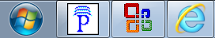
Office 2016 & The Partners Desktop
Find it - Outlook
  Outlook is still under the Partners P

Slide 5
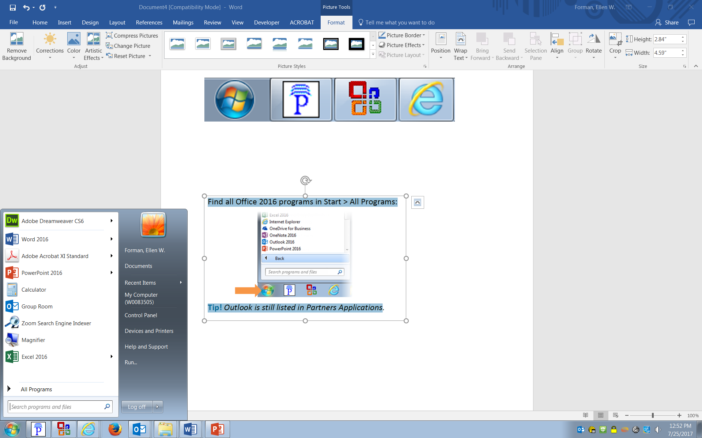
Office 2016 & The Partners Desktop
(continued)
Find it- Other Programs (Word, Excel, PowerPoint)
  Other Programs are under Start > All Programs (not Office Applications)
New Outlook icon

Slide 6
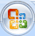
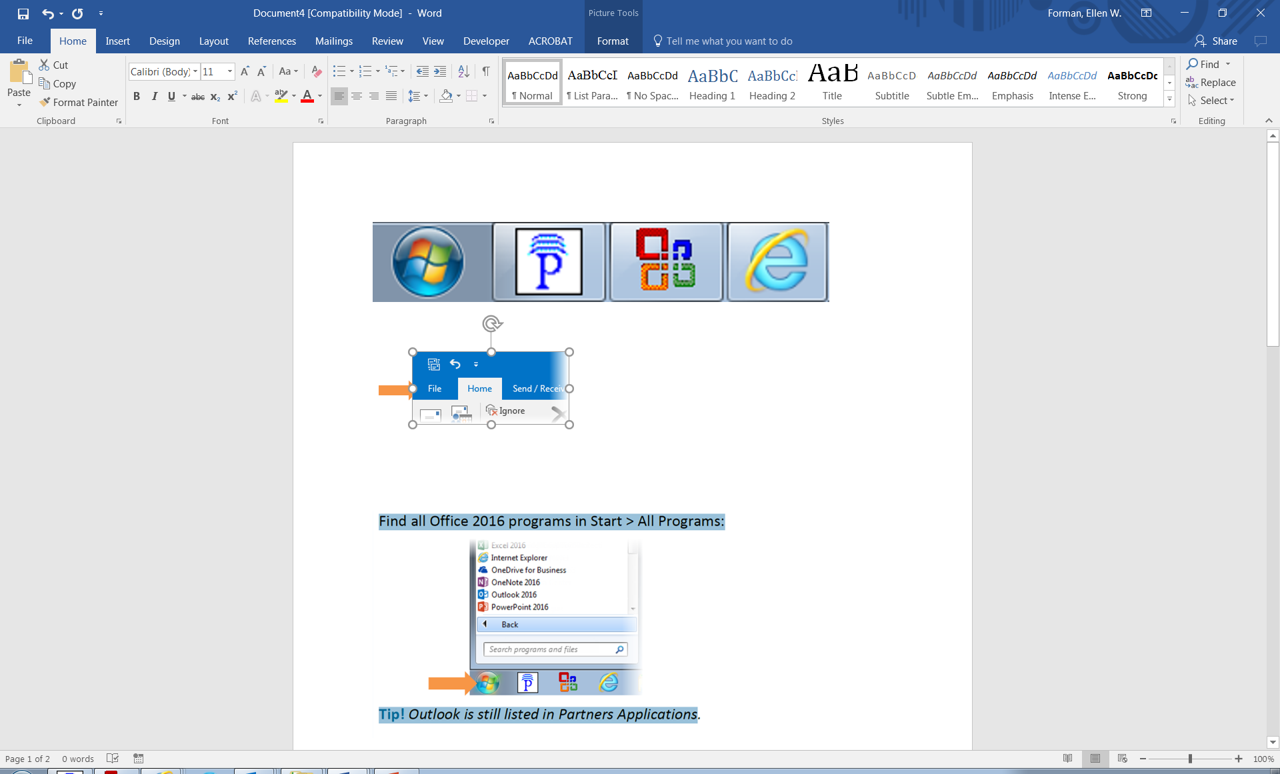
File Menu is back!
The MS Office button is gone, and File menu is back
  Find New, Open, Save, Save As, Print, etc. here

Slide 7
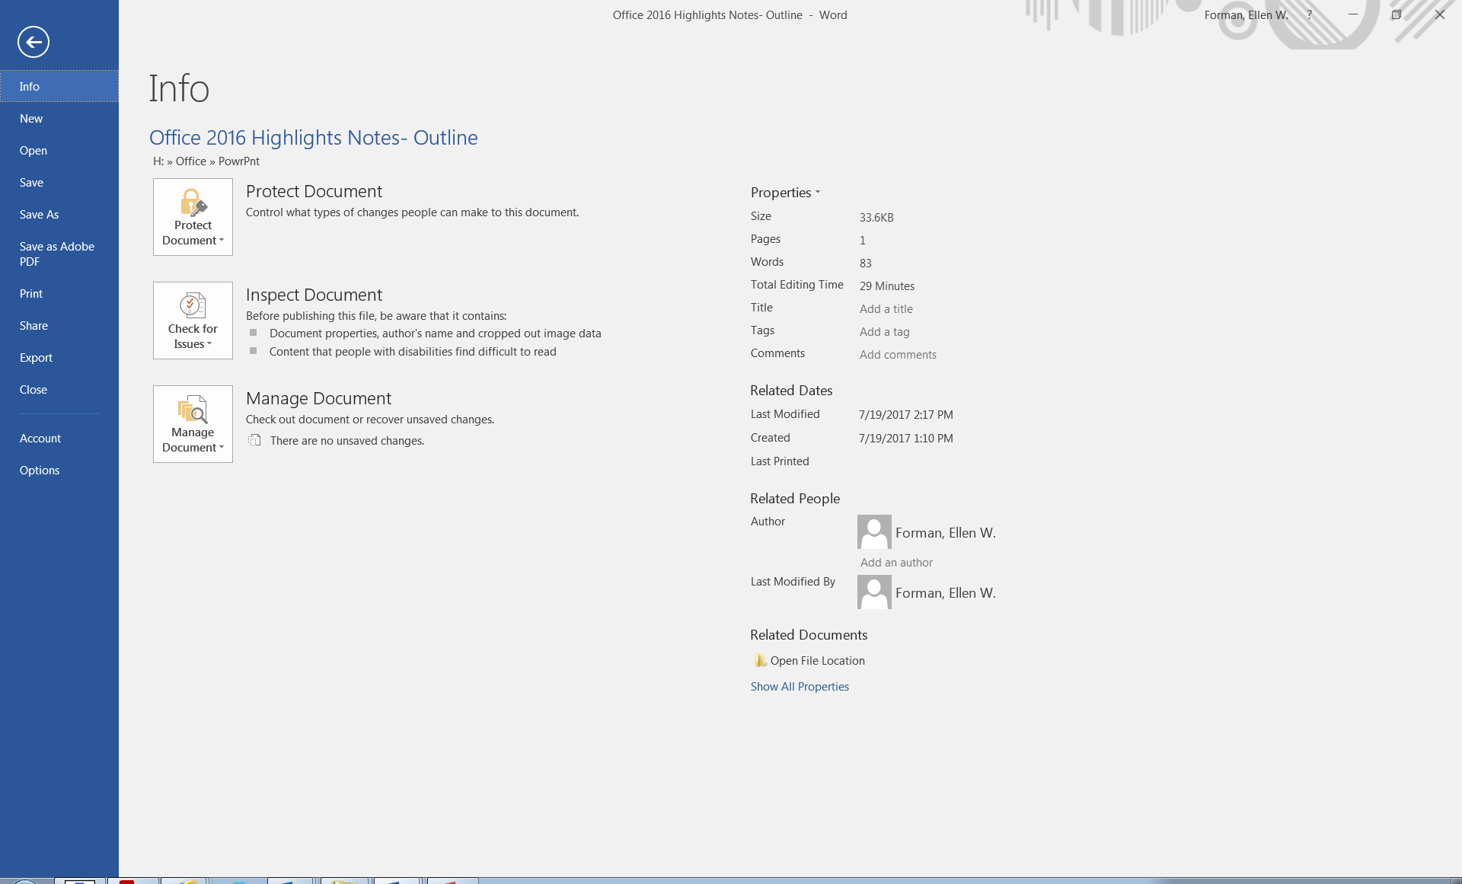
File Menu (continued)
BUT File opens a new view/page. Use back button.

Slide 8
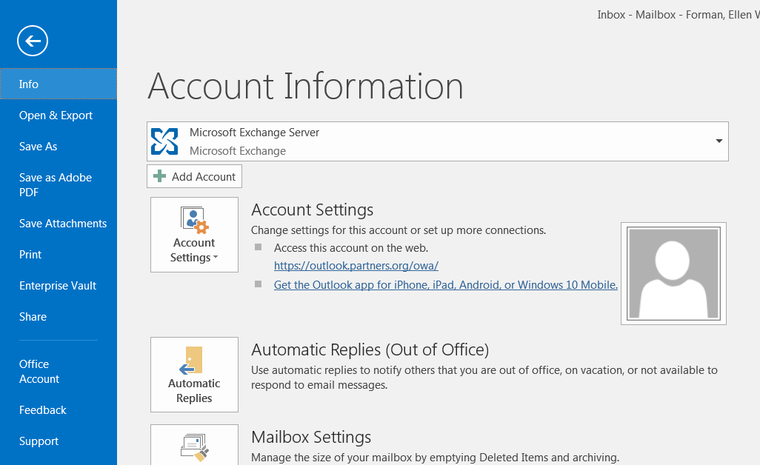
Outlook 2016 - Automatic Replies
Out of Office - now called Automatic Replies
Find Automatic Replies button under File Menu

Slide 9
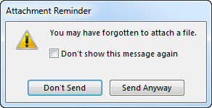
Outlook 2016 - Attachments
Outlook 2016 searches for keywords in your message, such as "see attached". If no attachment, displays reminder:

Slide 10
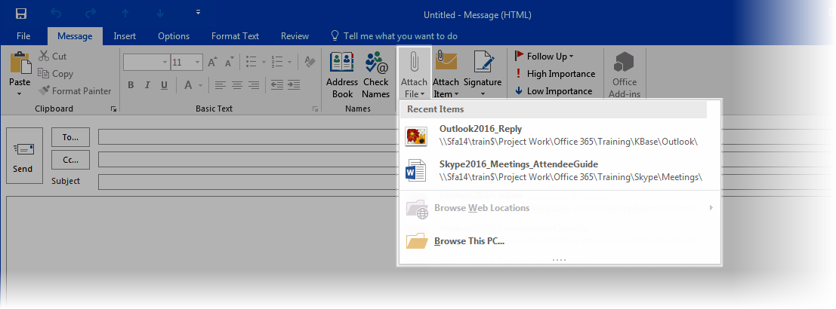
Outlook 2016 – Attachments (continued)
Now when you attach a file to a message, Outlook displays recent items, or select Browse This PC at bottom:

Slide 11
Saving Files in Word, Excel, or PowerPoint
Information Systems recommends saving files to your Home (H) drive (your personal file storage area) or a shared file area (SFA)- like our I drive
  Home drives and SFAs are backed up nightly and are accessible from any Partners computer

Slide 12
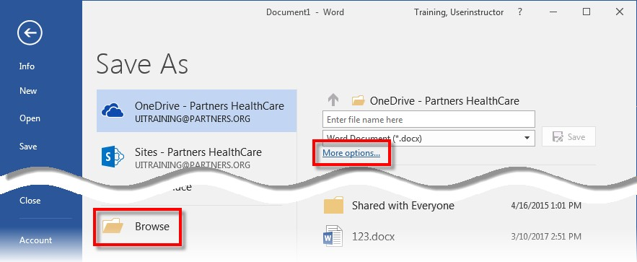
Saving Files (continued)
File > Save As
Use Browse or More options to navigate to H or I drive

Slide 13
Find Recent Files
File > Open takes you to your recently used documents and any files that you may have pinned to your list

Slide 14
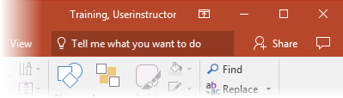
Tell me what you want to do
Help is now Tell me what you want to do
  Keyboard shortcut: Alt + Q
Can access tools and modify documents from within Tell me... search results
  Video demo on MGH training page

Slide 15
Questions? Tips from Other Users?
Reminder:
  Tips and helpful info- from the IS Communications upgrade e-mail (scroll to bottom of e-mail)
    Online Office 2016 information and tip sheets:
      Visit the Partners Office 2016 training & support site
      Review the Office 2016 “Getting Started” tip sheet

