Slide 1
Flexible Services for MGH Social Service

Slide 2
Medicaid ACO Overview
Background
What is an ACO?
Accountable Care Organization—health service delivery model that aims to achieve the triple aim of health service delivery to improve health outcomes, reduce costs and enhance patient care experience through value-based care coordination strategies.
Massachusetts is now 1 of 12 states implementing the Medicaid ACO
Contract with MGB→ MGB ACO (Model B)
All our primary care Medicaid patients are ACO
MGPO has > 37,000 beneficiaries, not including Nantucket and Martha’s Vineyard (~ 100K PHS-wide)
>51% pediatric
Practices with the largest membership:
Chelsea: 36%
Revere: 18%
Everett: 7%
Source: ¹ Matulis, R. and Lloyd J.; Center for Health Care Strategies. “The History, Evolution, and Future of Medicaid Accountable Care Organizations”, CHSC Brief, February 2018.

Slide 3
Flex Services
Allowing new services to be covered by MassHealth
MassHealth protocol approved for $149 million
Primary Goal: Address housing and food insecurity in high-risk patients who would benefit clinically and reduce TME
Secondary Goal: Encourage ACOs to partner with community service organizations to optimize addressing health related social needs.
Partners Health Choice ACO amount est. $5 million/yr
Tenancy Support
Nutrition Sustaining
80%*
20%*
Pre-tenancy: Individual
Pre-tenancy: Transitional assistance
Tenancy sustaining
Home modifications
Nutrition education
Food
Services (e.g., meal delivery, medically-tailored meals)
Social Service Org
Health System
Supports Medicaid ACO patients
Notes:
Program name: FLEX SERVICES

Slide 4
Flexible Service Program - Eligibility
Must have one of the following Health Needs Based Criteria:
Need assistance with one or more ADL or IADL
Behavioral Health Need
Housing
Be homeless, at risk for homelessness, or have unhealthy housing conditions
Repeated ED use - 4 or more ED visits in 1 year or 2 or more ED visits in 6 months
AND at least one
High risk pregnancy - with a diagnosis of
preeclampsia, gestational diabetes, a referral
to Maternal Fetal Medicine
Nutrition
At risk for nutritional deficiency or imbalance
Complex Physical Health Need
Behavioral Health Need
These criteria are what we’re looking for but we also do our best to accommodate where possible.
Looking at constellations of qualifications is a great way to think about eligibility.

Slide 5
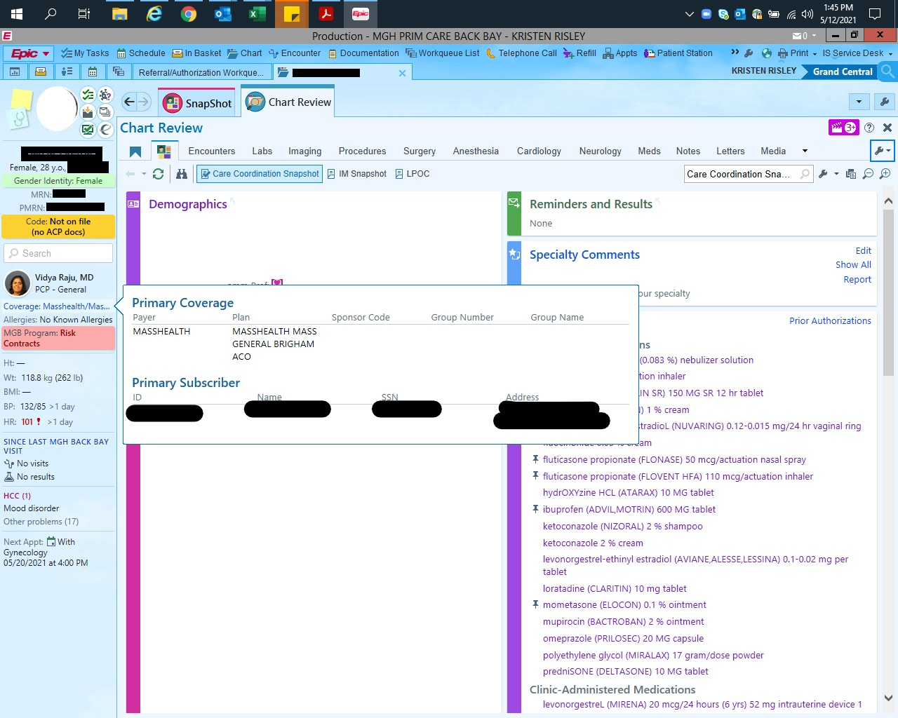
Identifying a Medicaid ACO Patient

Slide 6
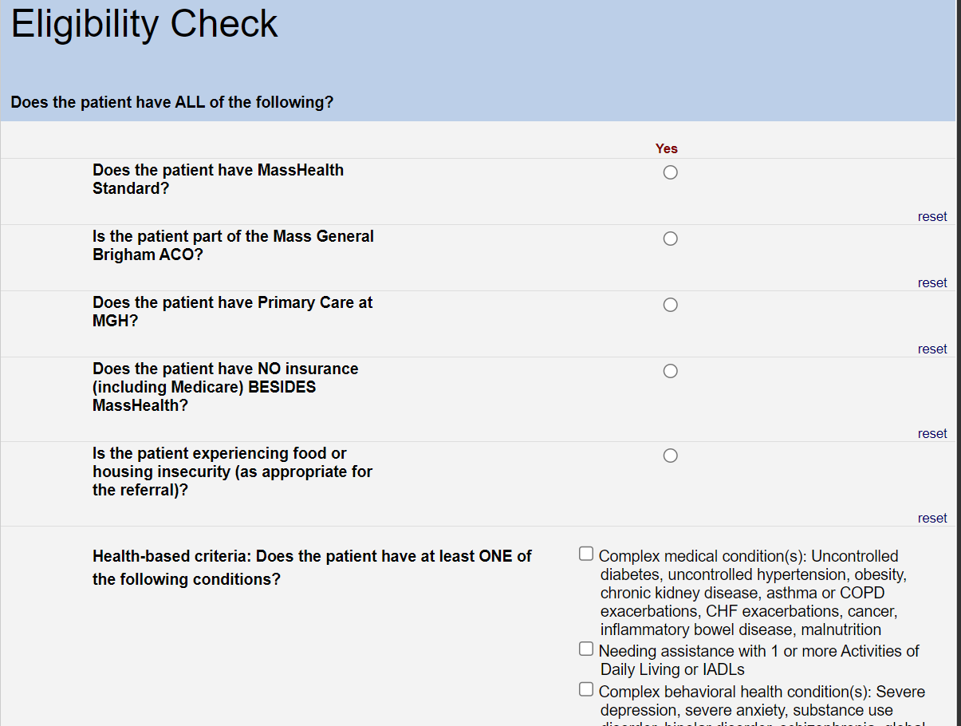
Flexible Services Referral Workstream
https://redcap.partners.org/redcap/surveys/index.php?s=JAHKAMMT878NDMJX

Slide 7
Flexible Services Referral Workstreams
What to expect if you refer
For housing it is generally 1-2 weeks before outreach from the vendor begins. We are working with them to bring that timeframe down.
With this in mind, if a patient has an urgent housing need and fits eligibility criteria, please email Bria bellishinds@partners.org with information to ask for an expedited outreach.
A case manager will be assigned to your patient from the housing agency. The case manager does an assessment and will let the patient know the extent that they are able to help with the need.
Services Range from:
Help filling out applications
Connecting patients with realtors
Helping with first, last, and security
Legal help through GLBS where appropriate
Education and support
For nutrition/food outreach is generally within 3 business days. Vendors call to ask about drop-off
locations and allergies/food aversions, etc.
Generally for Community Servings and Fresh Food Generation, deliveries start if not the same week then the next week
The debit card takes 2-3 weeks to arrive and needs to be activated by the patient

Slide 8
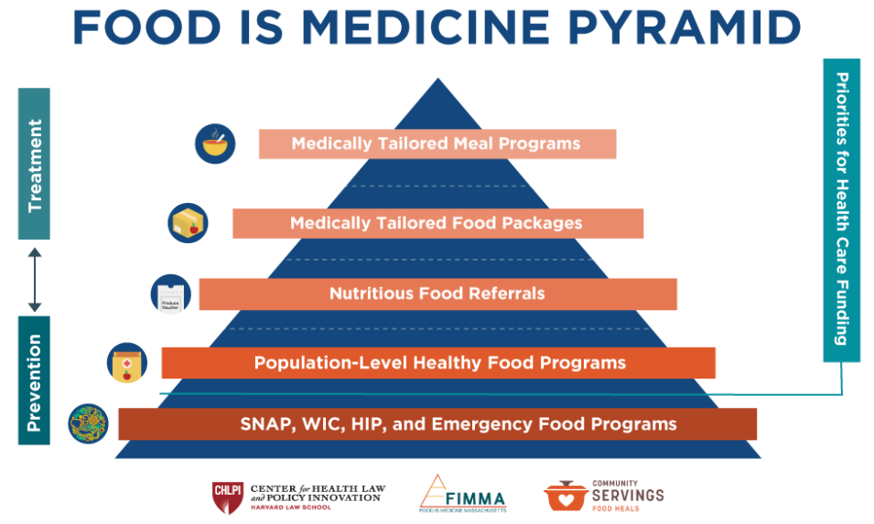
Developing at MGH a Tiered Food Intervention Model

Slide 9
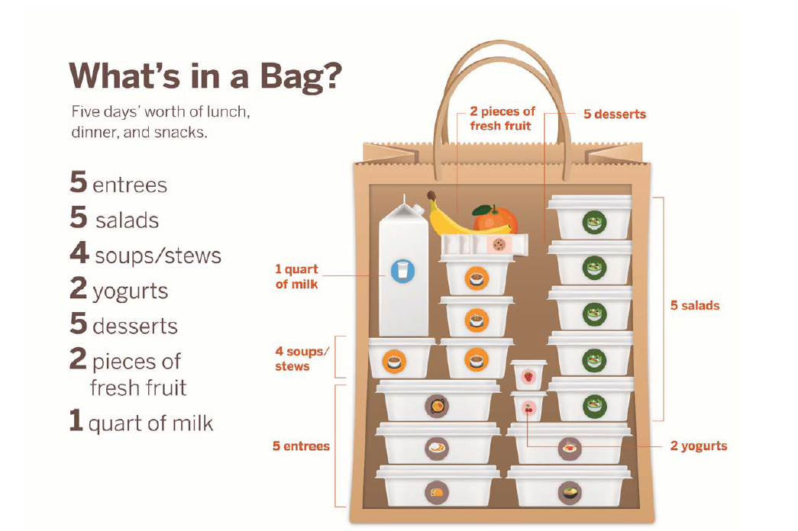
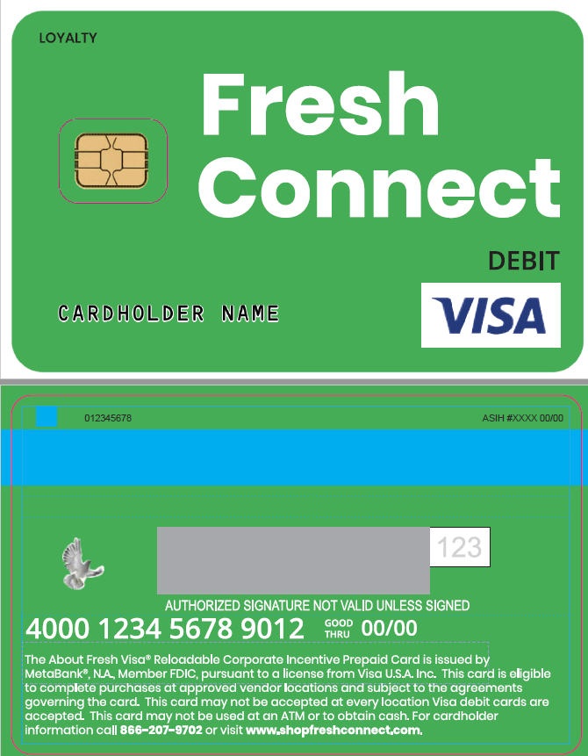
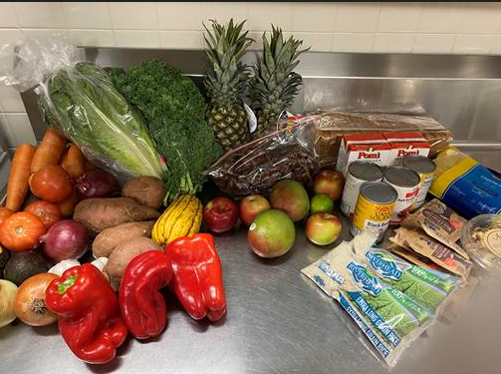
Flexible Services Referral Workstreams
Community Servings
Fresh Food Generation
Fresh Connect Debit Card

Slide 10
Addressing Food Insecurity Through Tiered
Flexible Services Programing
Program | Clinical Criteria | Considerations | Tier
Medically Tailored Meals (already prepared w/ nutritionist consult) Partner: Community Servings | Diabetes with A1c > 9 BMI > 40 CHF Class 4 ESRD Pedi Obesity > 99% Cancer | Consider for lower tiers if significant barriers to preparing own food | 1
Medically Tailored Food Packages (to prepare @ home) Partner: Fresh Food Generation | Diabetes with A1c 8-9 BMI 30-40 SBP > 160 CKD Pedi Obesity 95-99% GI/Crohn’s High risk pregnancy Malnutrition Failure to Thrive | Consider if difficulty leaving the house | 2
Debit card for Produce at Stop and Shop ($120 renewed monthly) Partner: Fresh Connect |  | Services household better | 2

Slide 11
Food: Flexible Services Patient Vignette
DB 61 yo male with SUDs, morbid obesity, asthma, COPD, DM II, and mood disorders.
Patient describes Community Servings food deliveries are AWESOME!
Thrilled to be able to experience fresh foods and learning new items and how to prepare them.
Program allows him to explore without talking himself out of it because he cannot afford to discard food if he does not like it.
Prepares new dishes with the provided items that he has enjoyed and not wasted.
Has been able to learn and prepare new recipes with his sister which help him manage his diabetes better than eating the overly processed, carb packed foods he knew and ate previously.
.

Slide 12
HOUSING: Flexible Services
Through care management synergy skill building many role groups have been extensively trained in Massachusetts housing and Housing system navigation basics.
MGH enrolls eligible Flexible Services patients with Metro Housing Boston which offers case management and some more longitudinal support than our staff can offer.
Lessons Learned:
Healthcare needs to help provide longitudinal roles to help with ongoing housing application management.
While multiple care managers roles have general knowledge, the work needs subject matter experts with access to real-time housing databases and pathways to real time application to openings.
We need ongoing and consistent training for care management staff roles
Different parts of the hospital see different needs to knowledge needs to be broad (ED, Primary Care)
We have an opportunity to develop SMEs

Slide 13
HOUSING: Flexible Services Patient Vignette
FL is a 51 yo male with DM, HIV, and complex social issues. FL has three teenage daughters who he has custody of living in a one room apartment. One of the teenagers was getting sexually harassed by neighbors and one was experiencing frequent SI.
With FL’s medical issues and the teenagers’ school schedules FL had difficulty figuring out how to move forward with a better housing plan.
FL worked with ED Navigator Kendra who connected to the Infectious Disease SW who had been working with FL on housing. An prioirity referral was placed via Flexible Services to Metro Housing Boston who connected with Kendra and the SW and then FL.
With quick work from Metro’s partner agencies, The Department for Community Housing and Development and Greater Boston Legal Services, within 5 days Fred and his children were place in a scattered site 3-bedroom apartment in Lowell.

