Slide 1
SNAP for College Students:
Unwinding the Public Health Emergency
Pat Baker, MLRI and Lorraine Ward, DTA
May 4, 2023

Slide 2
Today’s Training
Introduction and SNAP overview
SNAP and college students
SNAP during the Public Health Emergency
SNAP in Massachusetts post June 2023
SNAP household composition rules and students
The end of the SNAP emergency allotments and how to maximize SNAP benefits

Slide 3
Supplemental Nutrition Assistance Program
SNAP is a 100% federally-funded entitlement program.
Paid thru Electronic Benefits Transfer (EBT) – like a debit card.
Limited to food, vegetable/fruit plants & seeds (no hot prepared foods).
Over 5,500 EBT retailers in state, including farmers markets, CSAs as well as colleges with EBT markets.
Online purchasing options - https://www.mass.gov/snap-online-purchasing-program
SNAP households qualify for HIP benefits (Healthy Incentive program) at farmers markets, farm stands and CSAs.

Slide 4
Who qualifies for SNAP?
Most low-income households/individuals qualify - including:
Families with children and pregnant women
Older adults and persons with disabilities
Unemployed/low-wage individuals
Must be a U.S. citizen or meet certain immigrant rules.
Ineligible adults can always apply for eligible dependents.
Must must meet SNAP financial rules.
Gross income under 200% FPL
NO asset tests for most households.

Slide 5
Low-income college students & SNAP

Slide 6
SNAP and the College Student Rules?
SNAP eligibility rules apply to college students:
Ages 18 to 50
Enrolled in college half-time or more
Enrolled in a course of study that requires a GED or high school diploma (HiSET)
Since 1960’s, Congress imposed certain restrictions on students getting Food Stamps/SNAP - unless working part time or meeting certain “exemptions.” Many SNAP rules suspended during Covid.

Slide 7
Student SNAP Rules during COVID-19:
From January 2021 through mid-June of 2023, most low-income students are eligible for SNAP if they:
Have an expected family contribution (EFC) of $0;
Receive the maximum Pell grant; or
Are “eligible to receive” work Study - whether or not awarded.
These special Covid rules end June 9th. College students getting SNAP on or before June 9th will continue under these rules until their next SNAP renewal or “recertification.”

Slide 8
The “Regular” College Student Rules: MA has some of the broadest SNAP student policies in nation
Enrolled in community college or voc/tech program
Awarded Work Study and not refused a job offer
Receives MASSGrant financial aid,
Cares for child/ren under 12, or getting TAFDC cash assistance,
Has an incapacity or disability that reduces ability to work and attend school,
Enrolled in college through the SNAP ET program, OR
Working an average of 20 hours/week.

Slide 9
Community College students
Who’s SNAP eligible?*
Students enrolled in all 15 MA Community Colleges
Quincy College students
Franklin/Cummings Tech students
Regional Voc/Tech Students that offer post-secondary programs
Proofs required?
No DTA form needed. This may be self-declared (telephonic or in writing) unless questionable.
*Assumes students meet the financial and other SNAP rules

Slide 10
Work Study students
Who’s eligible?
Students awarded work study and the student anticipate working during the school period. BUT….
If a student was offered a work study job, and they declined the job, they are not eligible.
Proofs required? This may be self-declared (telephonic or in writing) unless questionable.

Slide 11
MassGrant financial aid students
Who’s eligible?
Students awarded MassGrant financial aid
Proofs required? This may be self-declared (telephonic or in writing) unless questionable.

Slide 12
Students with an incapacity/disability
Who’s eligible?
Students with an impairment or disability that impacts their ability to work 20 hours a week while attending school.
This includes students:
Receiving a disability-based benefit like SSI or EAEDC
Enrolled in school through the Mass Rehabilitation Commission (MRC) or
A physician, psychologist or other medical or mental health professional determines the student cannot work 20 hours a week and also attend school.
Proofs required? This may be self-declared (telephonic or in writing) unless questionable.

Slide 13
Student Example #1
Jane is age 23, a full time student at North Shore Community College majoring in Health Education.
Jane is SNAP eligible. She can declare her enrollment during the SNAP interview.

Slide 14
Student Example #2
Charles is a full-time student at UMass Boston. He receives a MassGrant award.
Charles is SNAP eligible and can self-declare his MassGrant during his SNAP interview.

Slide 15
Student Example #3
Raquel is getting her bachelors degree at Worcester State. She was awarded work study and is actively looking for a work study job.
Raquel is SNAP eligible because of her work study award. She can self-declare her work study during her application interview.

Slide 16
How does the end of the PHE Covid rules affect MA Students?
Very few Massachusetts students should lose SNAP eligibility - including students attending community colleges, students awarded MassGrant or work study, students with children or with disabilities.

Slide 17
Household Composition

Slide 18
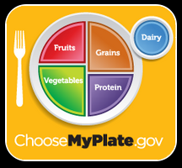
What is a SNAP household?
Persons who live together must be in the same SNAP household and apply together if they:
“purchase and prepare” most (2/3) of their food together - even if they are not related to each other*,
Are legally married spouses, living together,
Are children under age 22 living with their parents, OR
Are minors under age 18 living with responsible adults
*note special rules for persons with disabilities, see the Advocacy Guide

Slide 19
Household Example #1
Jane is age 23, a full time student at North Shore Community College. She lives with three other roommates. They share dinner a few times a week, but otherwise purchase and prepare most of their food separately.
Jane can apply for her own SNAP and be her own household.

Slide 20
Household Example #2
James, age 20 and a single parent attends Bunker Hill Community College. He lives with his working mom and 2 teenage siblings.
James and his child must be in the same SNAP household with his Mom and siblings - until he turns 22. He is not eligible right now for his own SNAP for himself and his baby. (He can apply for his own TAFDC cash grant if eligible).

Slide 21
Household Example #3
Susan, age 20, works part time and lives with her parents. She barely eats at home.
Susan must apply for SNAP with her parents. She is not eligible for her own SNAP benefits, even if she rarely shares food with them.

Slide 22
Household Example #4
Raquel moves on campus at Worcester State and gets a partial Meal Plan that covers her some of her meals but not all. She has kitchen privileges and cooks for herself, including on weekends.
Raquel is SNAP eligible because she has a partial meal plan. If her meal plan covered ⅔ or more of her meals, she would not be eligible.

Slide 23
SNAP and Financial Aid

Slide 24
What financial aid is countable for SNAP?
Educational income is not countable for any DTA program - SNAP or cash assistance.
This includes:
Grants,
Scholarships,
Assistantships, and
Fellowships.
This includes educational grants, scholarships, and educational stipends awarded by a college, a nonprofit organization or private company. However, if students working regular wages, that income does count.

Slide 25
The Monthly SNAP benefit

Slide 26
SNAP Benefit Amounts
Household Size | Max. Regular SNAP (as of 10/1/21)
1 | $281
2 | $516
3 | $740
4 | $939
5 | $1,116
6 | $1,339
Regular SNAP issued the 1-14th of the month depending on last digit of your SSN.
The federal extra (Covid) SNAP ended February 2023, last payment March 2nd.
Massachusetts is paying a 40% state-funded SNAP supplement for April, May and June.

Slide 27
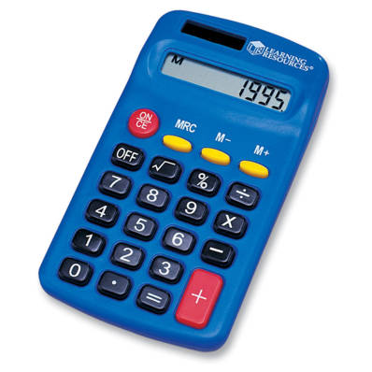
Maximize SNAP with deductions
If not getting the maximum SNAP amount in regular SNAP, be sure DTA knows:
Your current rent or homeownership costs,
Any child care costs for work, attending school, looking for work,
Child support legally owed and paid to a child outside the home,
and
Healthcare costs of SNAP recipients age 60+ or disabled.
Use MLRI’s SNAP Math calculator to see you are getting the maximum SNAP: Masslegalservices.org/content/online-snap-calculator

Slide 28
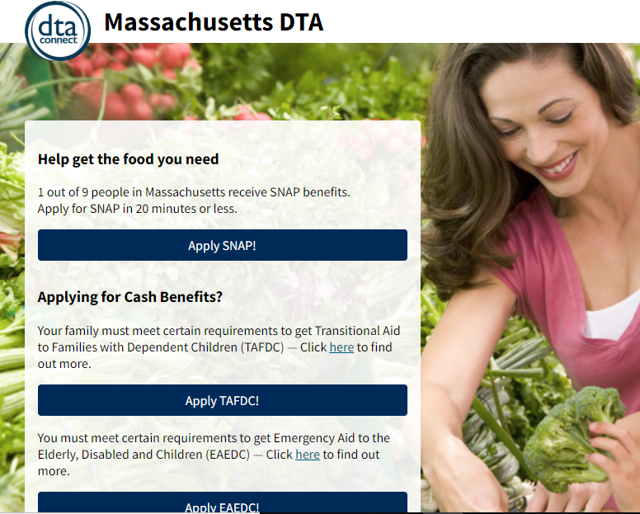
Apply for SNAP through DTAConnect

Slide 29
What happens next after applying?
DTA schedules an Interview, but households can call the DTA Assistance Line any time to do their interview.
DTA will ask for proof of key eligibility factors (if not provided with the application), such as:
identify,
residence,
countable income,
immigration status (if not a US citizen)
An EBT card is sent by mail or applicant can pick up at local office
Some needy households can qualify for “expedited” SNAP
Once on SNAP….
The household needs to report certain changes during certification period
And out a recertification form when DTA requests it (such as, once a year)

Slide 30
Check DTA Case Info/Reach a Worker
DTA Connect mobile app & DTAConnect.com:
Notices for last 12 months
Case status (+ EBT deposit history only on DTAConnect.com)
Upload documents
Update contact info
Request EBT card
DTA Assistance Line - (877) 382 2363
Specific case info via phone system without talking to a worker
Reach a worker for SNAP or cash
Update contact info
Request EBT card
Connect directly with DV help or Client Assistance Coordinator
Report loss of food due to misfortune for replacement SNAP

Slide 31
Talking points for reaching students
SNAP is like a grocery store gift card - up to $281/month in food benefits for 1 person household, more if with spouses or children).
SNAP is “financial aid you can eat.” SNAP can reduce other financial pressures, like books or travel costs.
Provides the EBT Card to Culture to museums and theaters, and MBTA Youth Discount (students under age 24).
SNAP households qualify for HIP benefits at participating farmers markets, farm stands and CSAs
It’s easy to apply for SNAP. Apply through www.DTAConnect.com from a smartphone or computer, by phone or at a local DTA Office

Slide 32
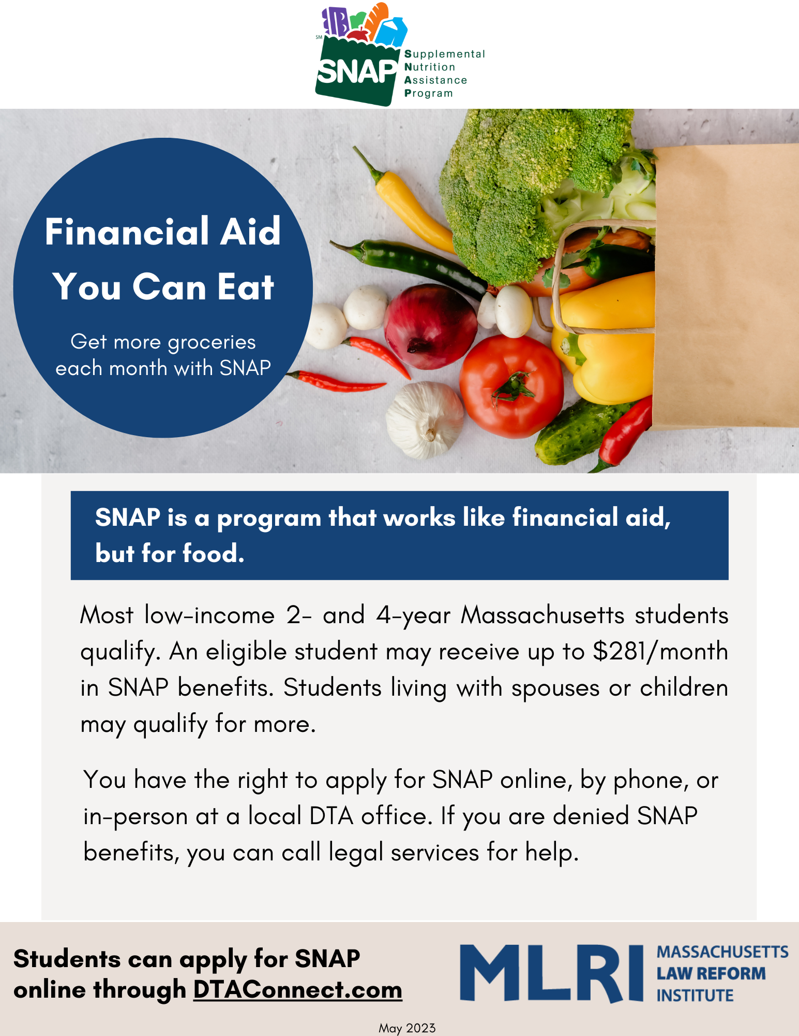
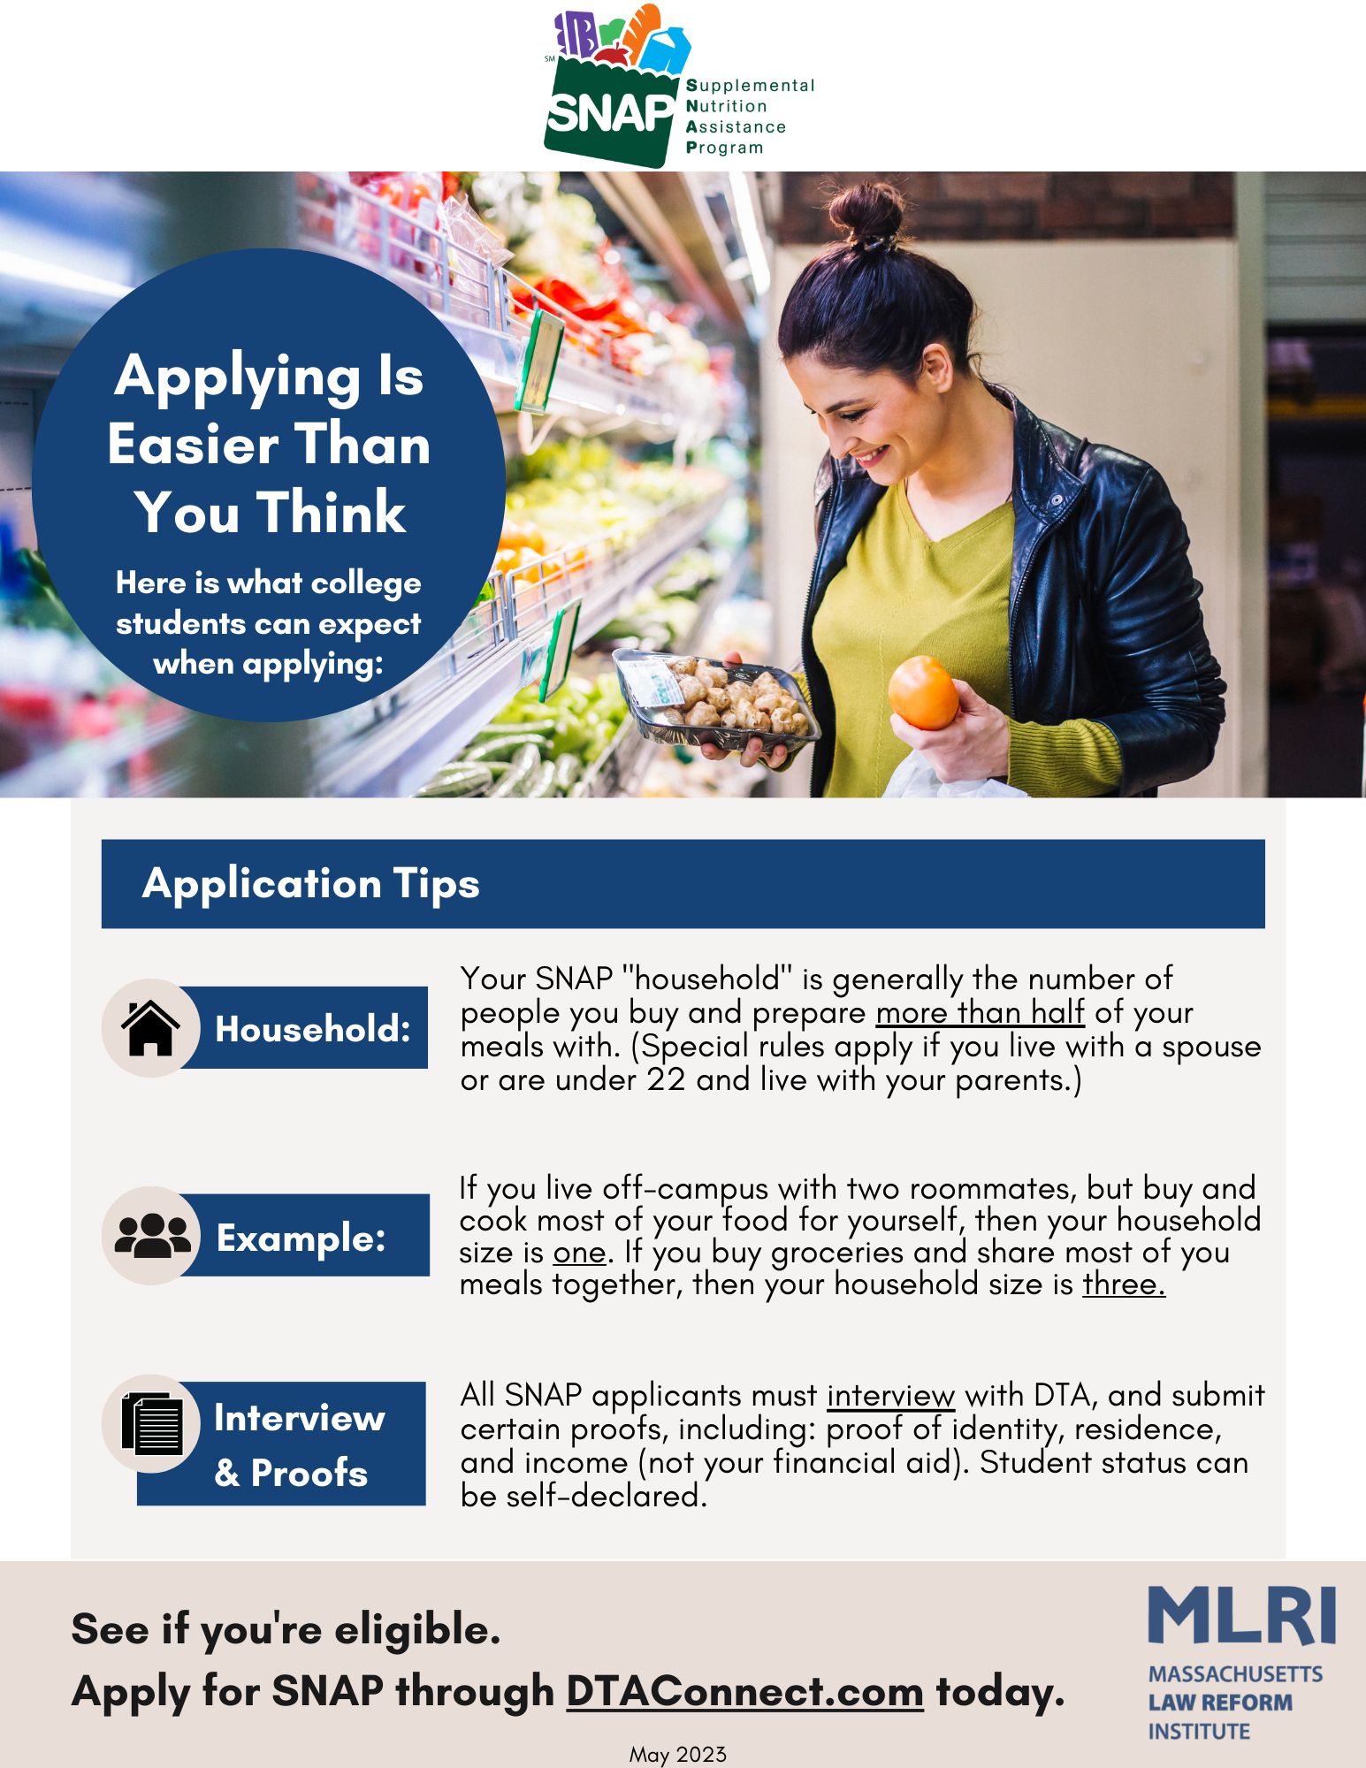

Slide 33
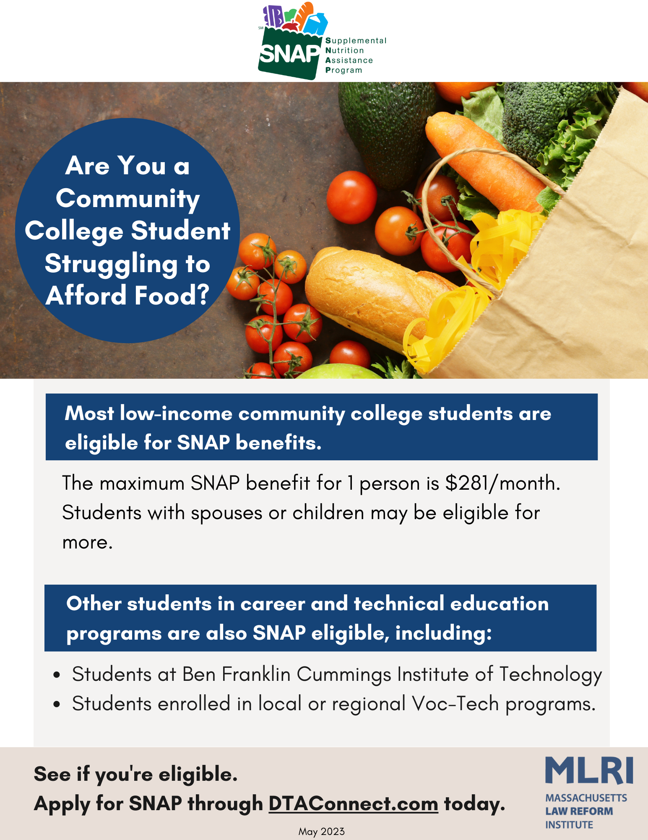
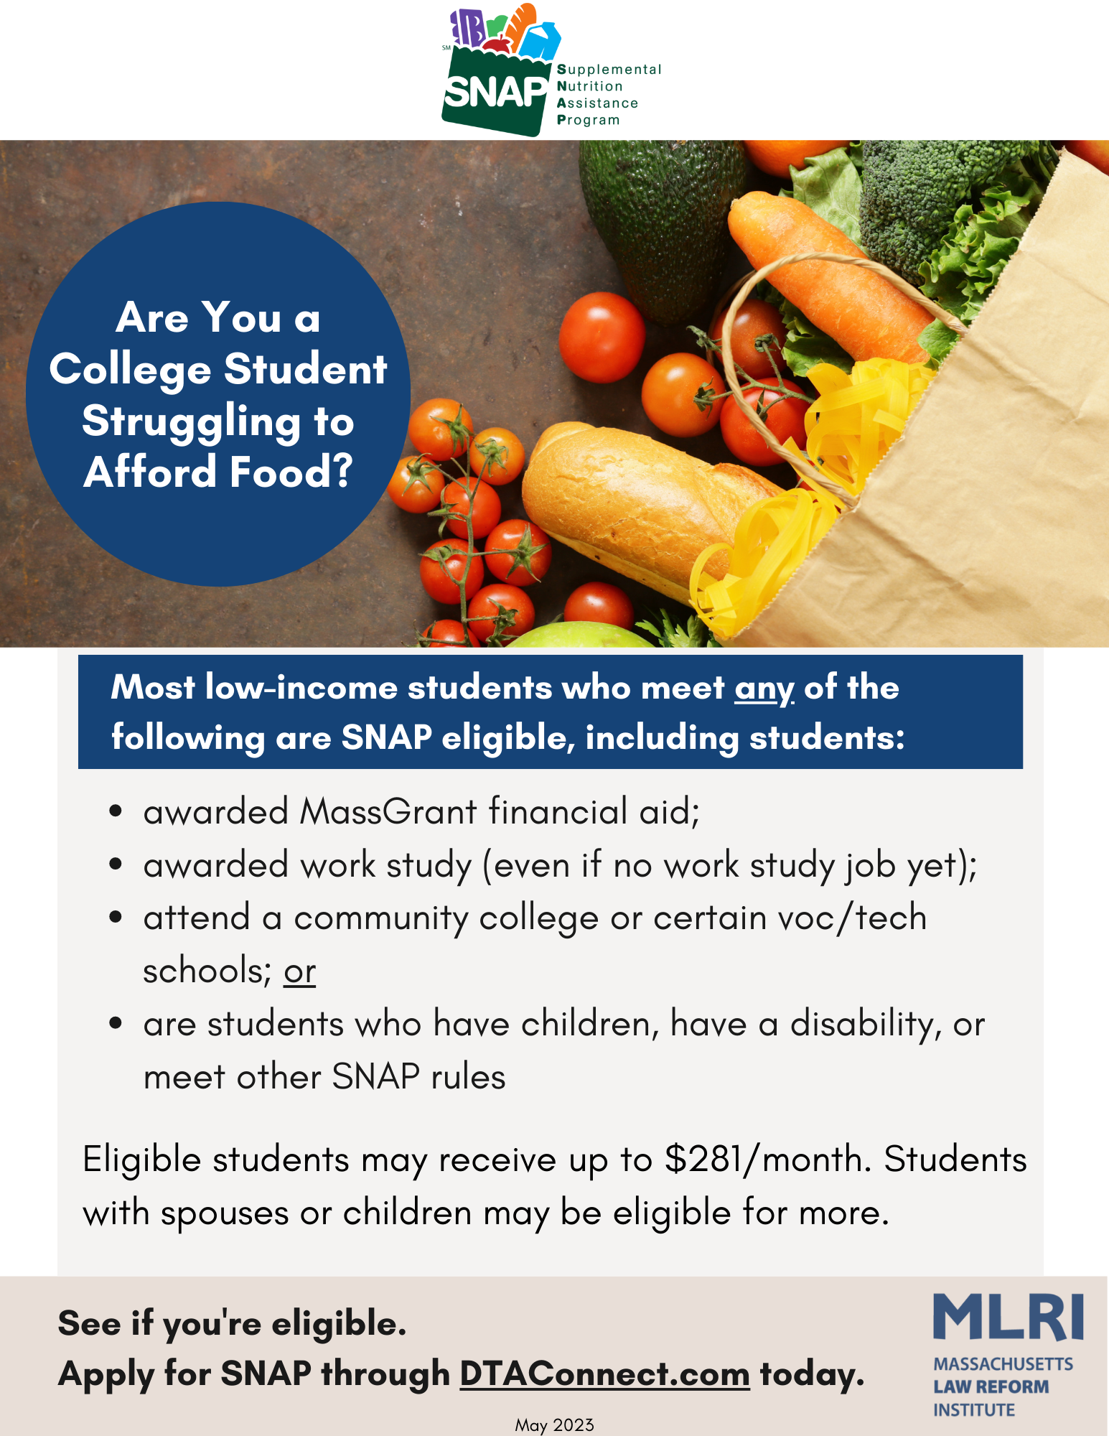

Slide 34
Emergency food resources
o Call Project Bread’s FoodSource Hotline: 1-800-645-8333
o Call Mass 2-1-1
o Direct info from the Food Bank in your area:
Greater Boston Food Bank: GBFB.org/need-food
Food Bank of Western MA: Foodbankwma.org/get-help/locate-a-local-feeding-program/
Worcester County Food Bank: Foodbank.org/find-food/
Merrimack Valley Food Bank: mvfb.org/member-agencies/

Slide 35
Additional benefits and resources
DTA Cash Assistance: TAFDC for families with kids/pregnant people, EAEDC for older adults/persons with disabilities with no or very low income. NO asset tests! DTAConnect.com
Chapter 115 Veterans Benefits: Needs-based state/local monthly cash benefit for MA Veterans, their dependents & parents of veterans. Mass.gov/service-details/chapter-115-benefitssafety-net-program
Child care subsidy: If not receiving TAFDC or in a SNAP Employment and Training Program, call 2-1-1 to get on waitlist - it is moving. See child care flyers.
Federal Child Tax Credit & stimulus payments: FindYourFunds.org
Rent, mortgage, and utilities: Call 2-1-1 or go to Mass.gov/covidhousinghelp
Money to help pay for the internet or a computer: ACPbenefit.org

Slide 36
THANK YOU !!
Pat Baker, Mass Law Reform Institute pbaker@mlri.org
Lorraine Ward, Dept of Transitional Assistance, lorraine.ward@mass.gov

