Slide 1
iCMP and other high-need care management programs
 | iCMP | iCMP PLUS | Community Partners | Social Determinants Community Health Workers/Navigators
Criteria for Eligibility – All programs require an MGH PCP | High-risk as determined by iCMP program review (unmanaged chronic conditions, ED use, potential for future admissions). | Very high risk patients whose needs are unmet by traditional system. Often high psych, SUDS, &/or very medically complex. Frequent ED/inpatient use | Patients with chronic conditions who can use long-term care coordination help, adults with BH needs that can be helped with therapy and/or care coordination in the community | Patients with MGH PCP who can benefit from short/medium-term support for health-related social needs
Payor type eligibility | Risk contracts including all MGB plans, some Medicare, Medicaid, Tufts, Blue Cross, and Harvard Pilgrim * | Medicaid ACO | Medicaid ACO | All payors
Referral process | Epic Order to iCMP | Epic Order to iCMP PLUS | Epic Order to Community Partners | Epic Order to MGH SDH or Equity & Community Health
What this program offers that’s different | Longitudinal care management with a nurse, SW, and/or CHW care coordinator working with the patient’s healthcare teams. | In-community/In-home medical care** (meet pts where they’re at), additional community stabilization resources for MH and SUDS | Community-based BH or LTSS care to help with MGH capacity issues | Help for health-related social needs and triage to other care management as appropriate
Time to Engagement and Length of Engagement | Depends on capacity, usually within a month Longitudinal based on need and patient goals | If deemed appropriate outreach starts in 6-8 weeks Longitudinal based on need and patient goals | Referrals can be fast-tracked but expect minimum 3 months for outreach and enrollment Longitudinal based on need and patient goals | Eyes on the referral within a week, waitlist varies. Able to accommodate urgent needs if specified. Max 4-6 months.
Age range | Pedi iCMP w/ pedi PCP Adult 18 and over | 18 and over | BH is 18-65 and LTSS is 3-64 | any
**Does not include PCA but can connect to services *** Referrals may be shifted based on case specifics
* Not all products are in risk contracts

Slide 2
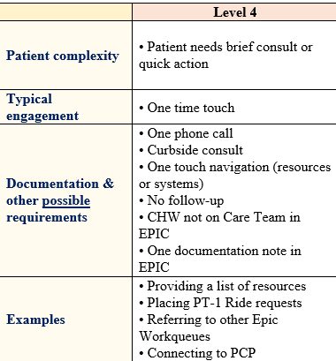
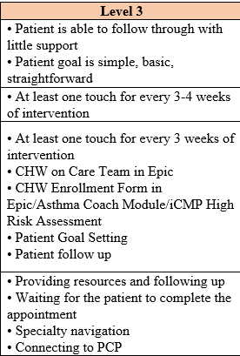
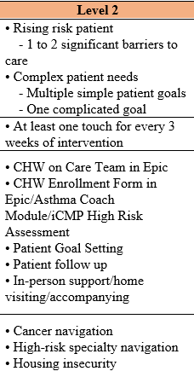
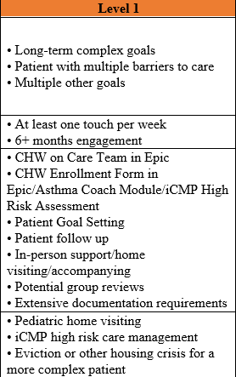
Community Health Engagement Matrix
These levels are assigned by staff after the initial patient assessment. The information is here to help staff
understand the types of care, length of engagement, and level of complexity this work is broken down into and
what kind of help a patient should expect to receive.

