Slide 1
A New Model of Compassionate Care for Trans and Non-Binary Patients Across the Hospital Setting
ASHER BRUSKIN, LICSW
(he/him/his)
ABRUSKIN@PARTNERS.ORG
MELANIE COHN-HOPWOOD, LICSW
(she/her/hers)
MCOHN-HOPWOOD@PARTNERS.ORG

Slide 2
Learning Objectives
Participants will learn about evidence-based-practices and interventions that are centered on compassion through the lenses of patient-centered-care and cultural humility.
Participants will learn about process of how one specialty hospital-based program working with a marginalized community has developed and applied best practice elements into a new clinical care model.
Paricipants will gain an understanding of how to link patients to care within the greater hospital system in a manner that is affirming to their transgender and non-binary patients.
Notes:
START: 10:05 (MEL)

Slide 3
Introductions & Process
Limit jargon – We will do our best to limit jargon. We encourage use of “chat” to clarify terms/concepts (if you don’t know, others are probably wondering, too!).
Use consent - We do not assume (multiple/layered) identities or lived experiences of others and will do our best to be aware of potential impact of our words and framings. We ask that you use this lens today, as well.
Use awareness around language, especially re: oppression (cis-sexism, hetero-normativity, racism, dis/ability). We are all learning and will make mistakes. It is our responsibility to hold ourselves and one another accountable to do the best we can and, when we make mistakes, to use humility and compassion, and to continue our work to do better.
Communication– Please do use the “chat” box! We will do our best to monitor and can address topics as able during or towards the end of the presentation. Some points might be best as follow up conversations!
Notes:
END 10:10AM (MEL)

Slide 4
WHY A SPECIALIZED TRAINING ON WORKING WITH TRANSGENDER AND NON-BINARY PATIENTS?
Notes:
ASHER

Slide 5
What is cultural humility?
Commit to self-evaluation and self-critique through humility & flexibility
How willing are we to say we don’t know something or to admit when we have made a mistake?
Commit to fix power imbalance and inequity!
Power dynamics always exist. The only way to reduce negative impact of power inequity includes shared naming of dynamics along with commitment to addressing negative impacts of power differential as it comes up.
[This is true both between provider / patient and among staff with different levels of identity and job-based power]
Through these tools, a partnership can be entered into, that is both open and flexible, and has established roles and boundaries built on transparency.
Notes:
END 10:15am - ASHER

Slide 6
VIDEO / NARRATIVE:
Patient Experiences in a Healthcare Setting
https://vimeo.com/262964980/368c8680d9
Notes:
VIDEO 10:15 - 10:30am - MEL

Slide 7
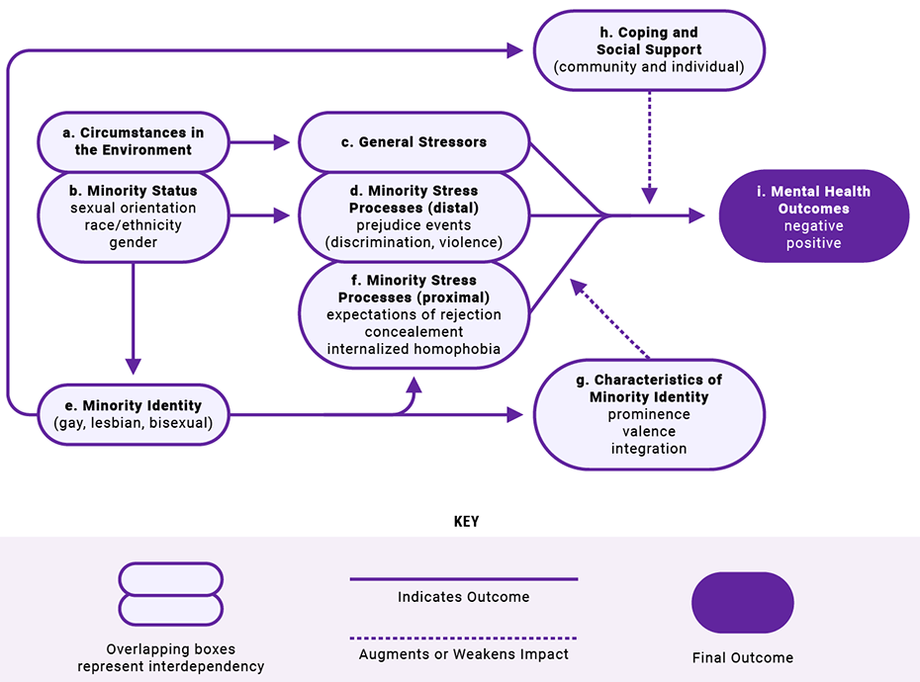
MINORITY STRESS MODEL
MINORITY STRESS MODEL
Notes:
10:30am - 10:40am - MEL
Invite chat: what are some of the things you heard in video?

Slide 8
PERSON IN ENVIRONMENT: MINORITY STRESS MODEL
46 y/o Black trans woman
Presenting for only hormones/gender affirming medical care, has PCP
Has always been interested in women, defines sexual orientation as being a lesbian
Prescribed feminizing hormones, spiro (testosterone blocker) and oral estradiol (estrogen)
Sx: Increased urination, otherwise feeling good with hormones, some questions about aging
Faith community
Insurance coverage
LGB community
Social affirmation
Victimization
*lesbian
*trans woman
*Black
Resources & supports
Trans* community
Positive relationships
work
friends
family
Community support
Medical affirmation
Disjointed sense of self
lesbian
Lack of identity cohesion
Black
Resource/income disparity
transgender
Coping
behaviors
Trauma
woman
$$ for uncovered services
Internal/external racism,
homophobia, sexism, transphobia
Intentional self-harm (harm reduction)
Social stigma
Stress cortisol
Untreated or chronic medical conditions
Isolation
Psychological and Medical Impacts
Substance use
Concealment of identities
Depression
Anxiety
Unexamined self-harm behaviors
Urinary issues
Notes:
Start 10:40 - 10:45am - MEL
Insurance*, formal and informal networks*
Multiple marginalized (and dominant) layers of identit(y)/(ies)

Slide 9
Identified Vulnerabilities and Gaps
Summary - Trans Equality Survey
Pervasive mistreatment and violence
Severe Economic Hardship and Instability
Limited access to health care, insurance, cost of treatment
Compounding Impact of oppression for those with multiple marginalized identities
Harmful Effects on Physical/Mental Health
Lack of trust in medical providers, systems
Notes:
ASHER

Slide 10
Takeaways from community
There is a need for access to competent medical AND mental health providers (and care)
There is a need for supports re: housing, economic support
There is experiential anecdotes and data that suggests a lack of general knowledge and training across professional disciplines (& within medical system)
There is an overall distrust of medical and mental health institutions within transgender communities.
Notes:
End 10:55am - ASHER

Slide 11
What models of care do we use in our clinic?
We made sure to include both medical (MD & RN) and mental health providers (SW and Psych NP) on our core team
We adapted an informed consent model to access care (re: notion of gatekeeping and pathologizing)
We agreed on values of cultural humility, much of which looks to the patient as expert on their experiences
We believe and validate patients who share about gender/identity
We join patients in naming power imbalance and acknowledge and honor distrust of medical and mental health systems.
Notes:
START 10:55am - MEL

Slide 12
INTERDISCIPLINARY NETWORK OF CLINICAL CARE SPANNING ACROSS THE LIFESPAN
Mental Health
OB/Gyn
Adult Primary Care
Pediatric Primary Care
Surgery
Endocrine
Notes:
MEL

Slide 13
Medical care and coordination
What Exists:
Trans Health Primary/Specialty (Endocrine) and Pre-surgical
Peds only specialty care
Psychiatry Gender Identity Program
Gender Affirmation Surgery Division
Transgender Action Group (TAG)
What we (THP) do:
Providing medical care (primary, hormones)
Referrals to specialty providers
Brief counseling, resource support, referrals
Consult service (trainings and social work/physician support)
Notes:
END 11am - MEL

Slide 14
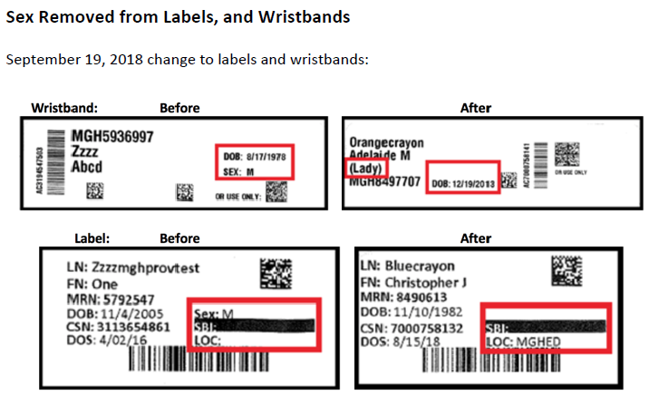
Updates to MGH / MGB policy!
Notes:
START 11am - ASHER

Slide 15
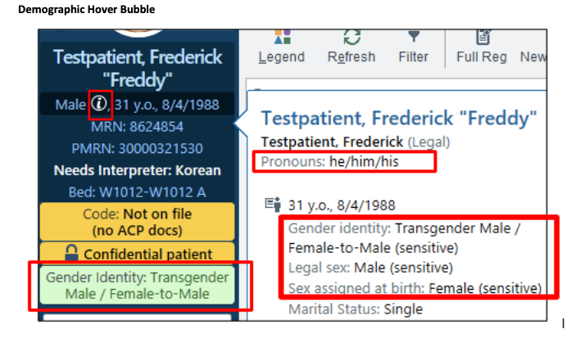
SOGI (sexual orientation & gender identity)
and Gender “X” (Nov 17th)
Add SOGI - https://peccutover.partners.org/tipsheets/All_EnteringSexualOrientationGenderIdentitySOGI_PHSE_TS.pdf
Notes:
ASHER

Slide 16
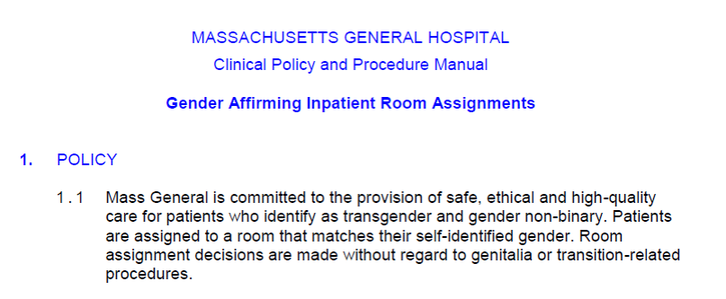
MGH Rooming Policy https://hospitalpolicies.ellucid.com/documents/view/18582
Notes:
END 11:05am - ASHER

Slide 17
Sexual Orientation & Gender Identity (SOGI)
What types of identified patient needs (and by whom?) prompts a SW referral for you to see patients in context of your practice?
What info are you given about patient identity/needs prior to meeting patients directly? What info are you typically not given (and would benefit from)?
How do you introduce yourself in the context of asking questions about identity, sexual health practices, etc.?
How do you think about balance between what you might want to know about identity and/or what you feel moved to share about your openness versus what you need to know in order to do essential SW support in context of your role?
Notes:
11:05 START - MEL
End 11:10

Slide 18
BEST PRACTICES: INTERVENTIONS WITH COLLEAGUES
Inpatient role play
You overhear a colleague refer to a patient using the incorrect pronouns. You notice their notes are also not affirming of the patient’s identity. What do you do? Would you feel different if the colleague were a social worker? An MD? Nurse case manager?
Nurses huddle outside the nursing station talking about not knowing where to room a patient and how this is hard for them. What do you do?
Outpatient role play
The MA calls for a patient by the name Jack, and someone who appears to be a woman gets up and follows the MA, who is now flustered and confused. What do you do?
Notes:
Asher
11:10-11:15am

Slide 19
Resources (in time of pandemic)
We only cover those in our clinics (for direct patient care), but please feel free to consult with us on your patients, connections to our clinic, or to community resources.
Community Resources
General/Adult:
https://docs.google.com/document/d/1j5TC692qmuvfE2c5Ps2n8F2iI1YAj3AJfXNDj95-uzE/edit
LGBQTIA+ Youth:
https://docs.google.com/document/d/1AeljijHnEjfq2BhqAgFcguhyUFpbB3Gg8f7ayK1bNDM/edit#heading=h.3qnjkq74b64s
Notes:
Asher

Slide 20
Takeaways
Commit to shared values, and use cultural humility frameworks and tools, especially when you are not part of the community for whom you are providing care
Look to community (individuals, organizations, agencies) to help identify strengths, assets and (health equity) needs and incorporate this into your practice at all levels of care, coordination, and communication
Be willing to interrogate systemic history that perpetuates oppression and inequity within yourself, your practice, and present power dynamics playing out
Remain committed to values and flexible to the need to adapt when needed
Be open to feedback and critique, and validate when mistakes happen
Identify current sources of distress and work with patients/families to mitigate or reduce harm where able.
Notes:
11:15 START - MEL

Slide 21
References
Colón, E. (2020, April 09). What is Community Asset Mapping? Retrieved October 02, 2020, from https://www.laundromatproject.org/what-is-community-asset-mapping/
Patient-Centered Care. (2020, April 01). Retrieved October 03, 2020, from https://www.cdc.gov/hiv/clinicians/transforming-health/health-care-providers/affirmative-care.html
The Report of the 2015 U.S. Transgender Survey: Executive Summary. (2016, December). Retrieved October 01, 2020, from https://transequality.org/sites/default/files/docs/usts/USTS-Executive-Summary-Dec17.pdf
Waters, A. J., & Asbill, L. (2013, August). Reflections on cultural humility. Retrieved October 02, 2020, from https://www.apa.org/pi/families/resources/newsletter/2013/08/cultural-humility

Slide 22
617-643-7210
MGHTransHealth@partners.org
https://www.massgeneral.org/transgenderhealthprogram/
@MGHTransHealth (Instagram, Twitter)

