Slide 1
SNAP: Verifications 101
Vicky Negus, Massachusetts Law Reform Institute
Webinar: January 11, 2018

Slide 2
SNAP Verifications 101 - Webinar Goals
  Verifications:
      Why important?
      What is needed and when?
      How do households know what to submit?
      How do households get verifications to DTA?
      What are core verification rights?
  DTA’s recent verification changes
  Troubleshooting and issues to flag

Slide 3

Why now?
DTA has overhauled the way they deal with verifications! The goal is…..
Paperwork
Barriers
Confusion
Denials for missing verifications
Access
Approvals
Customer Service

Slide 4

Why do we need YOU?
Knowing the basics of what DTA can ask for is huge
Sharing problems your clients are facing makes a difference – can change policy and DTA culture
Paperwork shouldn’t stand between low income households and food!

Slide 5

WHY are verifications important?
  Needed for eligibility/accuracy…
    Federal and state SNAP rules require proof of key eligibility
    DTA cash programs (EAEDC and TAFDC) also have verification rules
  BUT should not create eligibility barriers!

Slide 6

WHAT are verifications?
  Documents households provide, such as:
      Pay stubs or pension information
      Receipts or bills from health care providers
      Proof of legal immigration status
  Information DTA gets through state or federal databases, such as:
      Social Security (RSDI or SSI)
      MA Unemployment Benefits
      Child support through MA Department of Revenue

Slide 7


WHAT are verifications? (continued)
  Collateral contact - Information DTA confirms directly with a third party-usually when household is having a hard time getting proof (such as proof a job ended recently).
  Self-declarations – Written statements from the household DTA should accept (unless “questionable”), such as:
      U.S. citizenship
      Shelter (rent or homeownership costs)
      Type of utilities (heating/cooling, etc)
      Child care/adult day care costs

Slide 8

When is information QUESTIONABLE?
DTA may ask for more proof when information appears to be “questionable.”
Questionable means information must be INCONSISTENT with previous statements made by the client OR with other information DTA has.
Worker MUST write a case note explaining why something is questionable.

Slide 9

Questionable information: Case Example
Anne and her two kids get SNAP.
Example 1: She writes on her Interim Report that her work hours increased and her subsidized rent increased from $200 to $450 per month. This change is not questionable. It makes logical sense - rent is increasing because her family’s income increased.
Example 2: She writes that she no longer has any income but her rent increased to $450. Since DTA knows she is in subsidized housing, this does not make sense. DTA should ask for an explanation and may ask for additional proof.

Slide 10
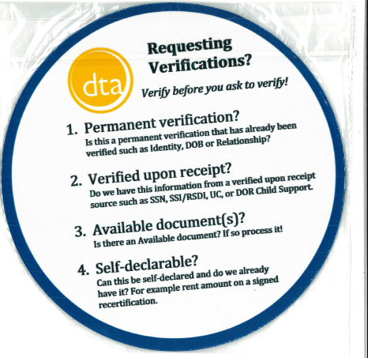
What changes has
DTA made?
Verification Checklist
DTA’s eligibility system, “BEACON”
Policy/guidance
Training
Culture/philosophy
Changes started 12/18/17!

Slide 11

What changes has DTA made?
Overhaul of Verification Checklist:
formatting
plain language
explanation and examples for each type of proof (verification factor)
specific details based on household circumstances

Slide 12
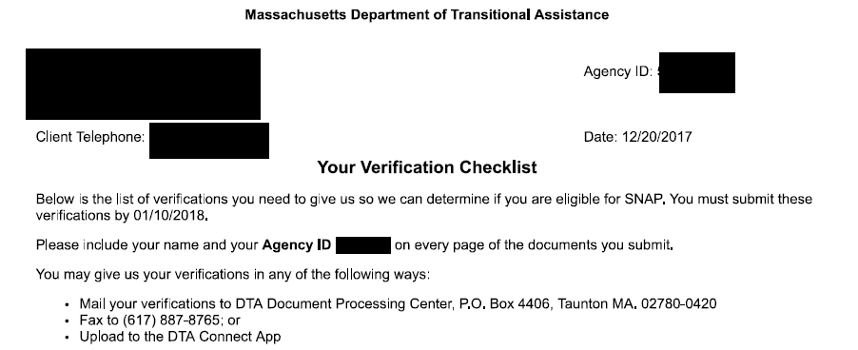
DTA Verification Checklist

Slide 13
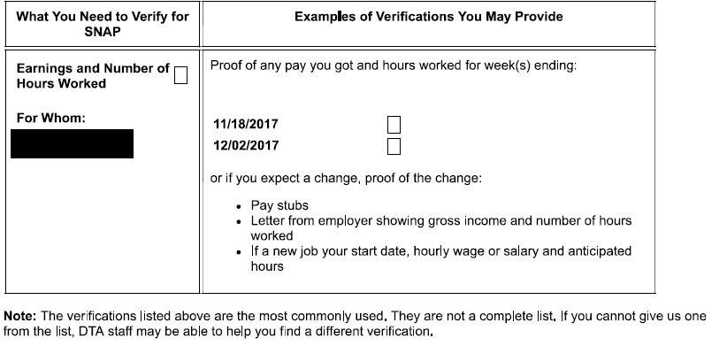
DTA Verification Checklist

Slide 14
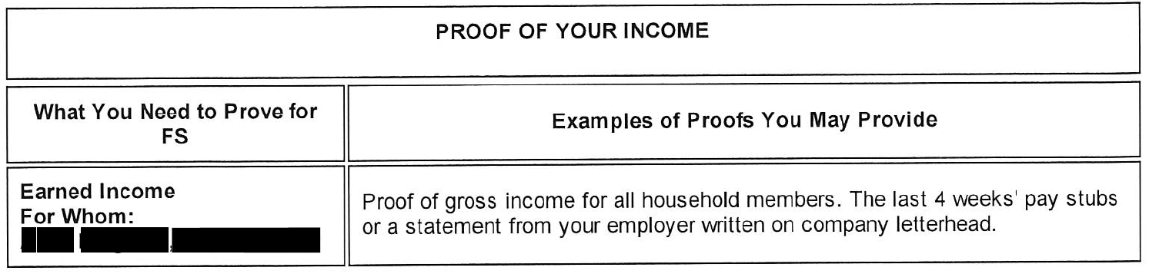
OLD Verification Checklist example: Earned Income

Slide 15
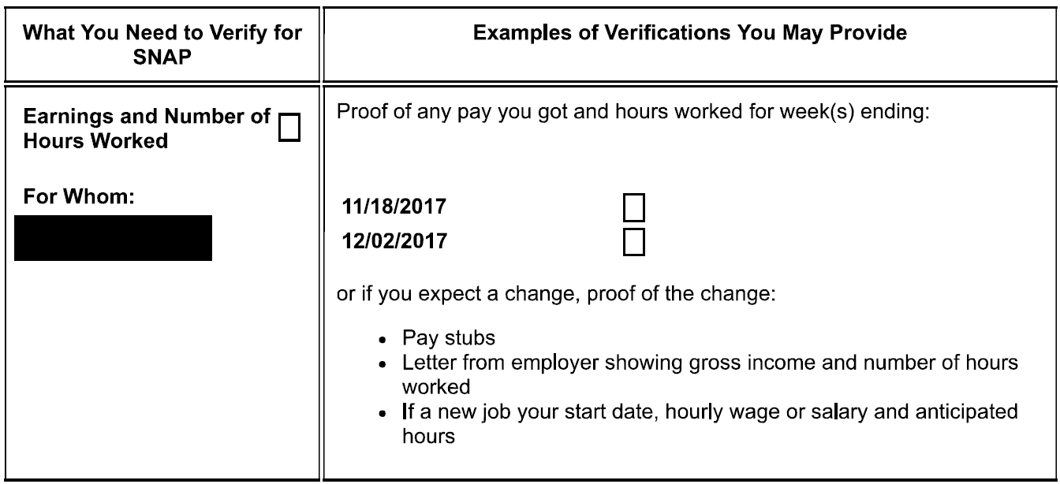
NEW Verification Checklist example: Earned Income

Slide 16
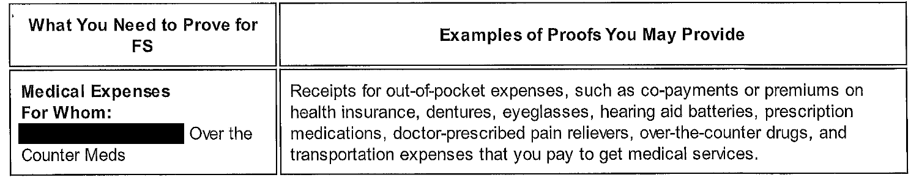
OLD Verification Checklist example: Medical Expenses

Slide 17
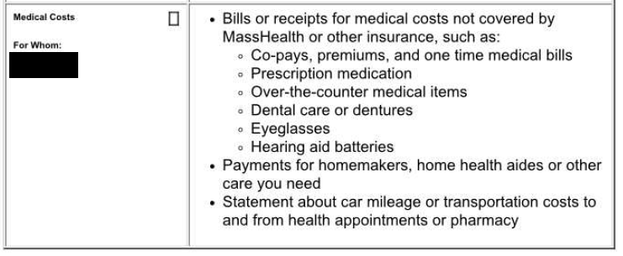
NEW Verification Checklist example: Medical Expenses

Slide 18

Changes to the system (BEACON)
Can’t ask for unnecessary verifications, such as:
    TAFDC/EAEDC cash verifications in a SNAP only case
    Information that can be verified via databases
    Verifications that are permanent and don’t change
Can’t send a Verification Checklist when DTA hasn’t looked at documents sent by the household

Slide 19


What training changes has DTA made?
Clarification of rules memos, trainings, and supervisor reviews
Culture shift excessive/unnecessary verifications hurts low income clients and burdens DTA

Slide 20
WHEN are households asked for verifications?
  At different points in the lifespan of a case…
  SNAP Application – DTA should discuss during the interview and mail Verification Checklist.
  Interim Report – DTA should send Verification Checklist if a reported change needs to be verified. No changes = no verifications!
  Recertification – DTA should discuss during interview and send Verification Checklist

Slide 21



HOW can you see what verifications DTA needs or processed?
DTA Connect - DTA’s mobile app:
  Notices DTA sent in last 3 months
  Type and status of documents DTA got in last 3 months
  Household can UPLOAD documents
  My Account Page (MAP):
  Notices DTA sent in last 12 months
  Type and status of documents DTA got in last 12 months
  DTA Assistance Line: 1-877-382-2363
  Call to talk with a DTA worker and ask what verifications are still needed.

Slide 22
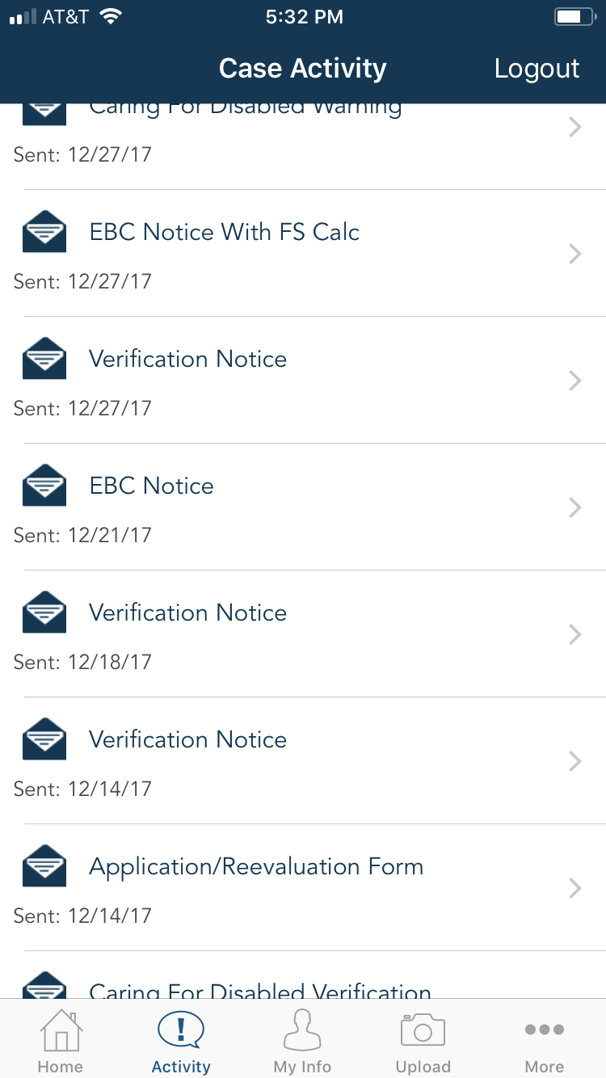
DTA Connect
Screenshot
View notices sent in the past 3 months, such as:
Verification Notice (“VC-1”)
“EBC notice” may include missing verifications
    EBC = “Electronic Benefit Calculation” EBC notices are approval, denial, or termination notices with a calculation attached

Slide 23
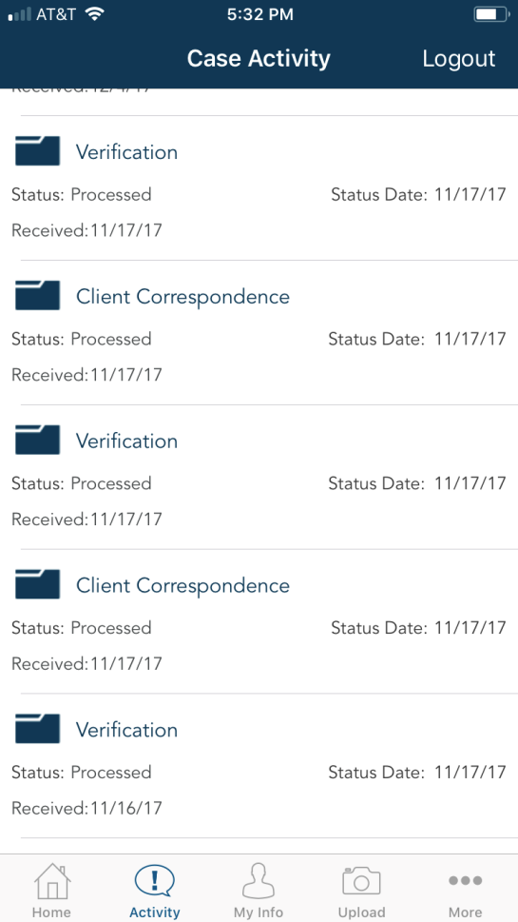
DTA Connect
Screenshot
View types of documents DTA got in the past 3 months – this can help if you’re not sure if or when a client sent in verifications.

Slide 24
HOW can a household get verifications to DTA?
  Upload through DTA Connect!
    Take picture and upload directly to household’s DTA case record
  Bring documents to any local DTA office
    DTA has scanning machines - upload documents directly to case
    Household has right to meet with a worker if they want (in case it’s urgent, etc)
  Fax: 617-887-8765
  Mail to:
Advocacy Tip: Follow up to make sure DTA looks at the document!
          DTA Document Processing Center
          P.O. Box 4406 Taunton, MA 02780-0420

Slide 25
WHAT has to be verified at SNAP application?
Identity
    DTA confirms when verifying SSN with the Social Security Administration
    Other proofs acceptable if necessary
MA residence
    DTA can confirm with RMV if client has MA ID or MA driver license
    Other proofs acceptable if no MA RMV record
Income
    “The Work Number” (if employer participates)
    Social Security, SSI, DOR Child Support and Unemployment databases
    Pay stubs, letter from employer, self employment proofs
Legal immigrant status - if immigrant is including themselves in SNAP application

Slide 26
WHAT can be verified at application to boost SNAP?
Shelter costs and type of utilities (self declare)
Child or adult dependent care costs (self declare)
Medical costs for household members age 60+ or disabled
    Documents showing amount of out-of-pocket health costs (generally, a couple of months enough to show recurring costs)
Child support paid to child outside of household
    Documents showing amount of child support paid AND proof of legal obligation (eg. court order)

Slide 27
Core verification RIGHTS:
Self-declare certain expenses
DTA must consider any reasonable proof submitted
Get help from DTA – “worker assistance”
Have DTA accept the “best evidence available”
Get case re-opened within 30 days
Appeal a denial or termination

Slide 28

WHAT does DTA worker assistance mean?
DTA workers are required to help clients get verifications.
Help doesn’t mean just one thing!
  Explain different types of proof documents
  Discuss a “reasonable accommodation” due to disability
  Do a “collateral contact”
  Explain self declarations
  Check to see if proof is already on file
  Look at data from other agencies
  Accept the “best evidence available”

Slide 29
WHAT does it mean for DTA to accept the best evidence available?
DTA cannot require households to produce something that they can’t get or that doesn’t exist.
DTA should accept the best evidence available. Clients should not be denied for missing verifications if the client and DTA have done everything they can to get proof of something.
This comes up most often when verifying income.
Notes:
Specific rules on income verification: 106 CMR 363.210(A)
“when all attempts to verify the income have been unsuccessful because the third party providing the income has failed to cooperate, and all other sources of verification are unavailable, the Department shall determine an amount to be used for certification purposes based on the best available information. If the household has no income, a statement from the household that it has no income shall be acceptable verification.”

Slide 30

Best evidence available: Case Example 1
  John is 52 and lost his full time landscaping job
  He is working under the table for $10/hour 10 hours/week until can get a new job
  John applies for SNAP, DTA asks for a letter from employer
  Employer tells John he won’t write a letter and threatens to fire him for asking.

Slide 31
Best evidence available: Case Example 1
What does John do?
Send DTA a letter stating how much he is paid and that his employer refused to verify. He also asks DTA not to call his employer because he is fearful of losing his job.
What should DTA do?
This is the best evidence John can provide and the best evidence DTA can get. DTA should approve the application with $100/week in earnings.

Slide 32

Best evidence available: Case Example 2
  Janet is 78 and lives with her husband
  Her income is RSDI and a monthly pension of $150
  Her pension is deposited directly into her bank account
  She does not get monthly statements from the pension employer
  She has been retired for 15 years and does not know how to reach the employer

Slide 33
Best evidence available: Case Example 2
What does Janet do?
Send DTA a letter stating how much her pension is per month, with a copy of the bank account deposits. Explain she does not have other verification because her employer does not send paper statements and she doesn’t know how to get in touch with them. Give DTA permission to call the employer.
What should DTA do?
This is the best evidence Janet can provide. If they can find contact information, DTA can try to call the pension employer- but if they are not successful, they should accept the best evidence available and approve the application with a pension amount of $150/month.

Slide 34
Verifications to flag –proofs DTA can get from other state/federal agencies
Verification factor | When concerning to see on a Verification Checklist | Why important?
RSDI (Social Security Disability, Retirement or Survivor) | Always | DTA should get proof from SSA
SSI
Unemployment Benefits |  | DTA should get from DUA (UI Online)
Child Support | When client gets child support and it’s paid through MA DOR | DTA should get from DOR

Slide 35
Verifications to flag – times DTA should accept self-declaration
Verification factor | When concerning to see on a Verification Checklist | Why important?
Utility costs | Always if was self declared- this means written on: Application Interim report Recertification Any other written note or document | Don’t need to prove unless questionable. Ask DTA what was questionable!
Housing costs (rent or homeownership costs)
Dependent care costs
US citizenship

Slide 36

Verifications to flag – other issues.
Earnings and Number of Hours Worked
Contribution Income
Reason Job Ended
Living Above Means

Slide 37
TROUBLE SHOOTING:
What to do if there are problems:
  Call the DTA Assistance Line – talk with a worker and then Supervisor
  Call the Ombuds Office: 617-348-5354
  File an appeal (ask for a hearing)
  Call your local Legal Services office
  Contact MLRI: Vicky Negus (617 357 0700 x 315) or Pat Baker (x 328) or email VNegus@mlri.org or PBaker@mlri.org

Slide 38
Resources
  MLRI SNAP Advocacy Guide (2018 Guide coming soon!): Masslegalservices.org/content/2017-food-stamp-snap-advocacy-guide
Sample DTA release form: Masslegalservices.org/DTA_release
DTA Connect information: Masslegalservices.org/DTAConnect
DTA Online Guide Verification policy
MLRI SNAP/Food Stamps 101 Advocacy Training: Thurs, January 25, 2018 from 9:30 am–12:15 pm at MCLE in Boston. Sign up at MCLE.org

Slide 39

QUESTIONS?
Your work makes all the difference for low income families in Massachusetts – THANK YOU!

