Slide 1
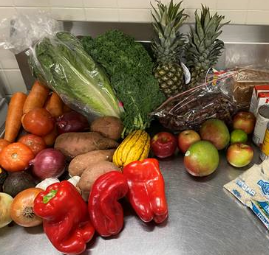
MassHealth Flexible Services: Nutrition
What is MassHealth Flexible Services?
A program started in 2020 that provides food and housing supports to patients who have chronic medical or behavioral health conditions and food or housing insecurity.
What nutrition services can patients receive?
Medically tailored meals from Community Servings Meals, snacks, and healthy desserts delivered to the home weekly
Produce and grain boxes from Fresh Food Generation Fruits, vegetables, and healthy grains delivered to the home weekly
Fresh produce debit card from Fresh Connect Debit card sent to patient with monthly limit of $120 to spend at Stop and Shop on fresh fruits and vegetables
Image shows Fresh Food Generation box
Who is eligible for Flexible Services?
Patients who are members of the MGB ACO and have food insecurity and one of the following conditions that isn’t improving with traditional healthcare:
Complex medical conditions:
Uncontrolled diabetes, uncontrolled hypertension, obesity, chronic kidney disease, asthma or COPD exacerbations, CHF exacerbations, cancer, inflammatory bowel disease, malnutrition
Needing assistance with 1 or more Activities of Daily Living or IADLs
Complex behavioral health conditions: Severe depression, severe anxiety, substance use disorder, bipolar disorder, schizophrenia, global developmental disorders (e.g. autism)
High Emergency Department use: 4 visits in 1 year, or 2 in 6 months
High-risk pregnancy: Gestational diabetes, pre-eclampsia
How do I refer a patient for Flexible Services? Use the following links:
Community Servings for medically tailored meals (please include condition) OR
Fresh Food Generation for fruits, vegetables, and grains OR
Fresh Connect for debit card
Email Jude Weinstein-Jones with questions about the programming.
Rev. 1/27/2022

